Slide 1
איפיון מוצר
שם האפליקציה:Instagram
חברי הצוות:

Slide 2
Main Pages

Slide 3
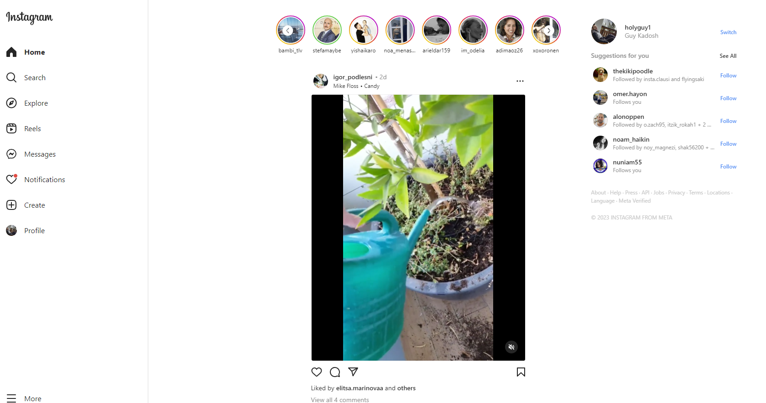
Home page
Story list
User
Suggested Friends
Additional links
Post list
NavBar

Slide 4
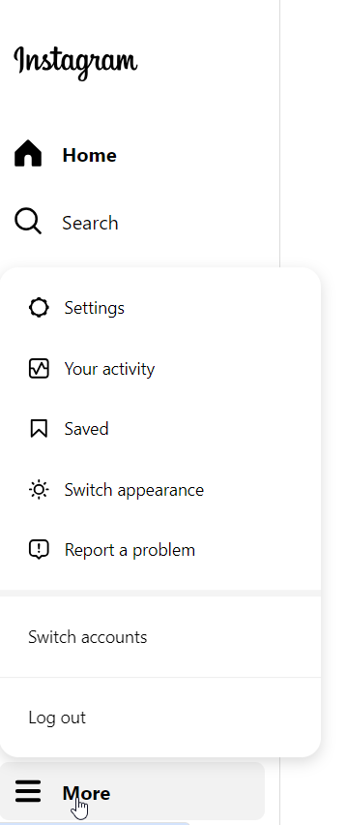
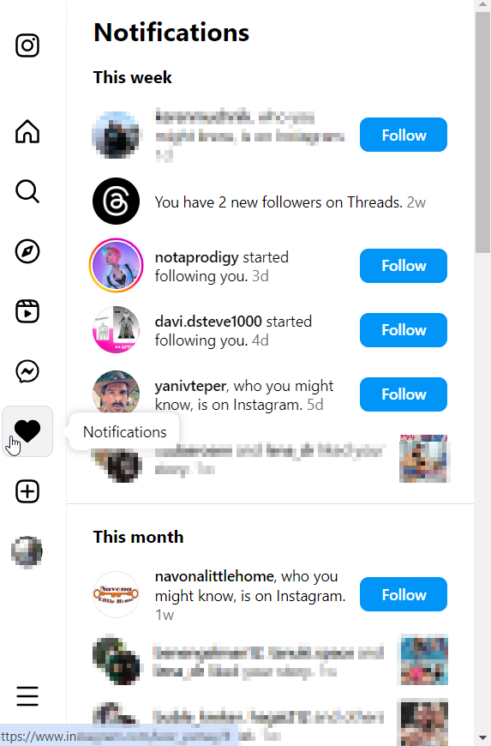
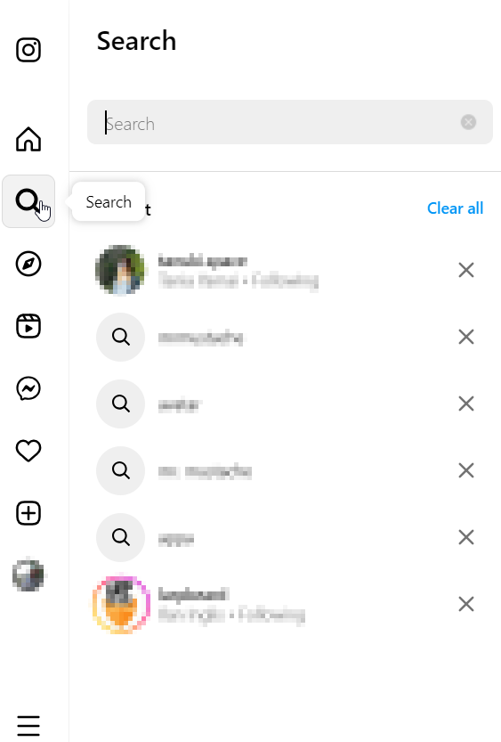
From NavBar
Popouts from navbar without adding params
Notifications bar
Search bar
More options

Slide 5
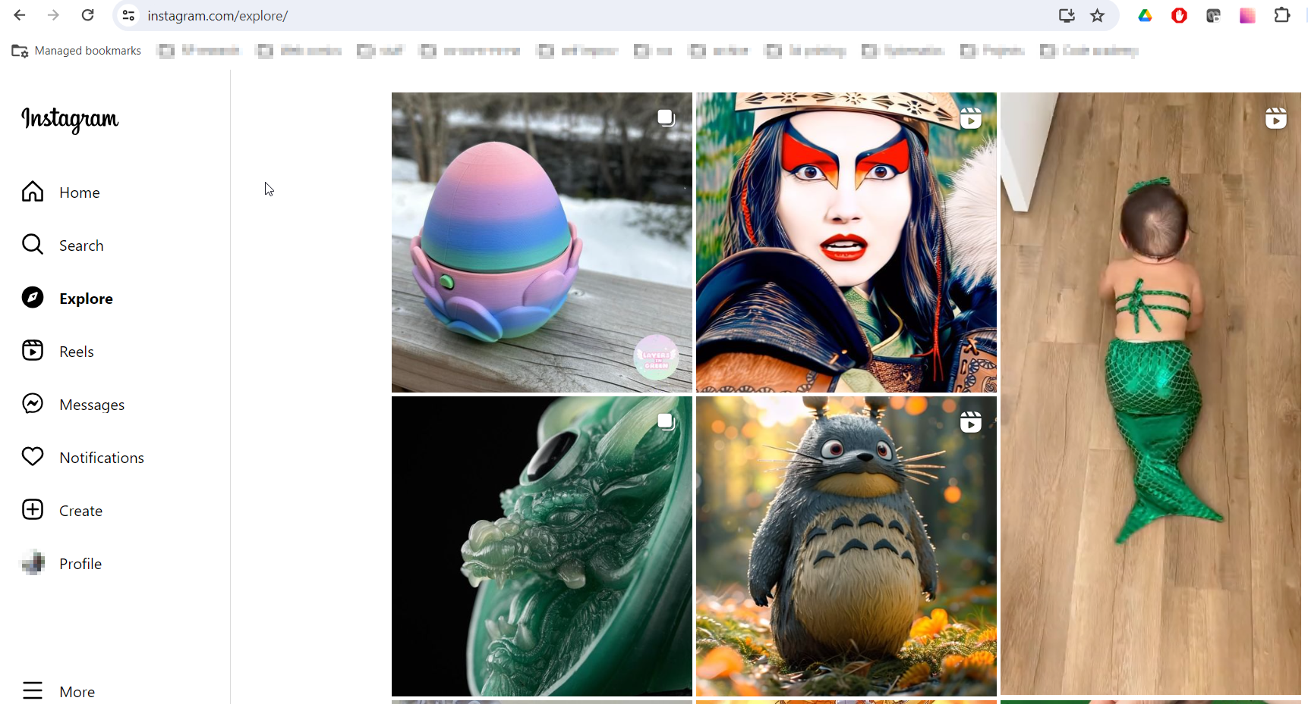
Explore page
Post grid
NavBar

Slide 6
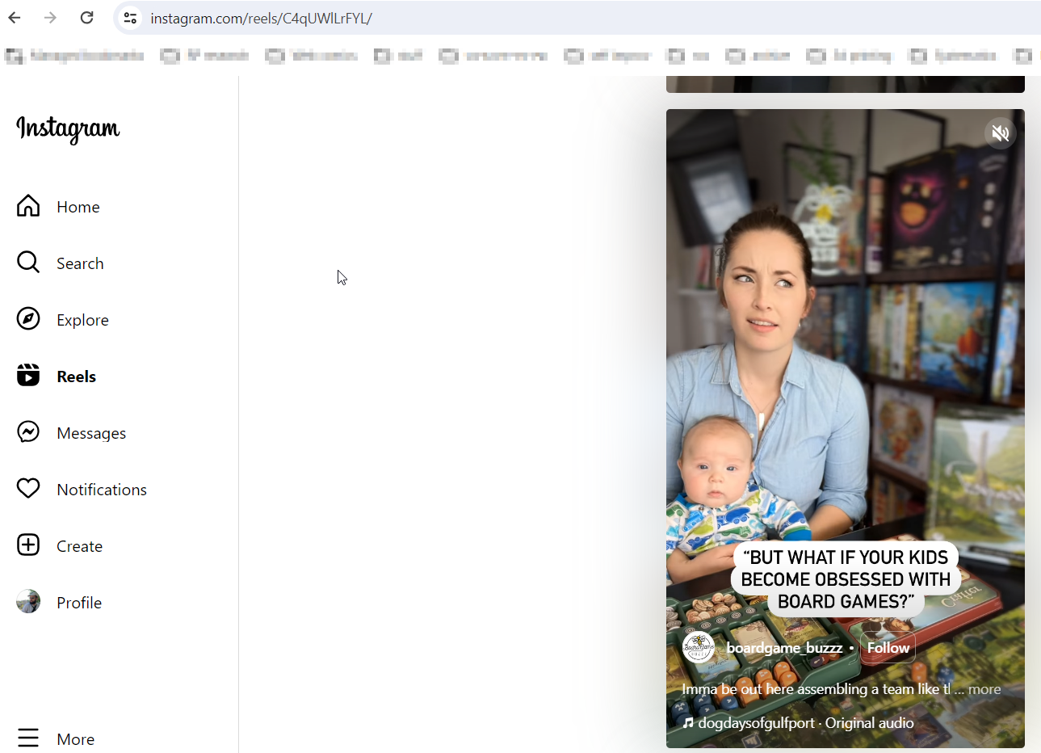
Reels
Opens on specific reel
Reel list
NavBar

Slide 7
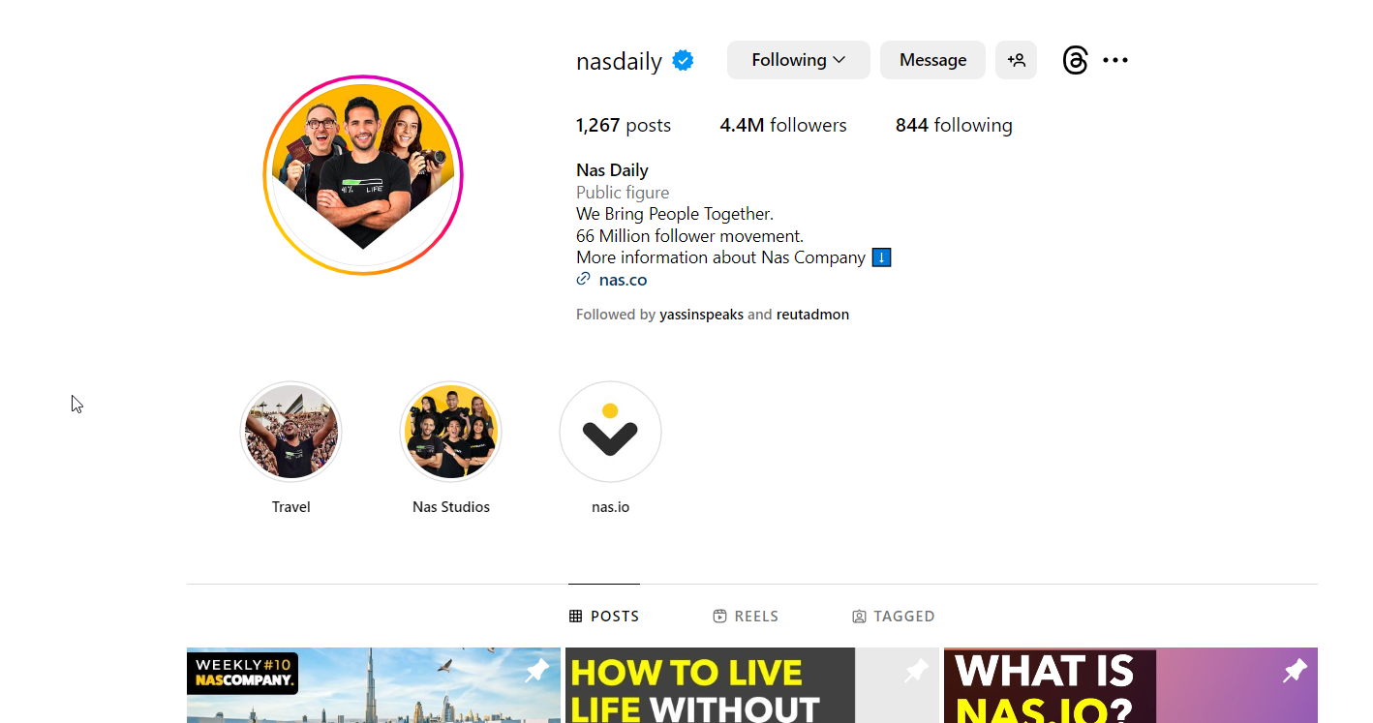
User Details page
Actions
User img
Highlights
NavBar
Post list

Slide 8
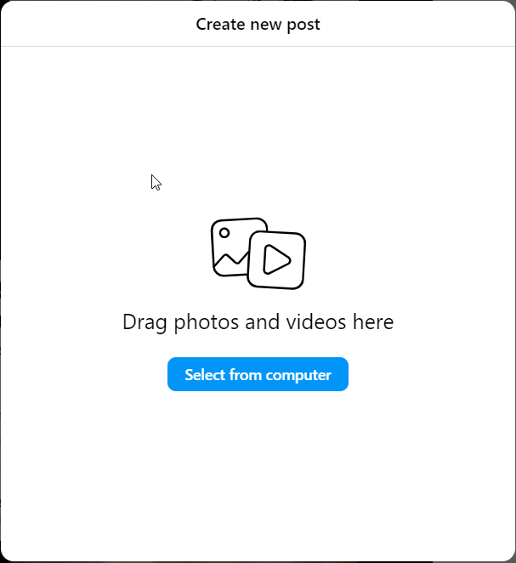
compose

Slide 9
Main Flows

Slide 10
Flow like/unlike post
User clicked like
Update storage
reRender post

Slide 11
Flow follow/unfollow user
User clicked follow
Update storage
Update following user
Update followed user

Slide 12
New comment, edit, delete
?

Slide 13
Flow

Slide 14
Flow

Slide 15
backoffice

